Slide 1
C 2019

Slide 2
THE SAMARITAN Program:
A nationwide, standardized program that vets, educates, and equips community-safety-minded volunteers, empowering them to more adequately deal with violent encounters, and enhancing their ability to collaborate, communicate, and interact with comparably trained civilian volunteers, as well as law enforcement, so that together we can save more lives.
The contents of this presentation are registered with the Writer’s guild of America, and the United States Copyright Office.
C 2019

Slide 3
The Facts:
In order to engage in a relevant dialog on the feasibility of the civilian population acting to save lives in violent situations, we must begin with a realistic and accurate assessment of the current state-of-affairs with regard to violent crime, law enforcement’s responsibility to respond to and deal with violence, and how civilians responsibly factor into that equation.
C 2019

Slide 4
Gun Fact vs myth:
Despite popular misconceptions to the contrary, good citizens who carry a concealed gun, whether off-duty law enforcement or civilians, do not carry a gun so they can take another’s life, they carry a gun so they can save other’s lives.
C 2019

Slide 5
current problem:
Too often a lack of communication between legally armed citizens, including off-duty cops, who act to stop violence, and on-duty responding officers can lead to catastrophe:
Chicago, IL, November 11, 2018 - 26-year-old Jemel Roberson was an armed security guard working in a bar when he witnessed a shooting in the bar. Roberson subdued the suspected shooter and held him at gunpoint until police arrived, at which point they saw Roberson holding a gun, and mistakenly shot and killed him.
Hoover, AL, November 22, 2018 - Gunshots inside the Riverchase Galleria Mall on Thanksgiving Day created mayhem for shoppers, as Emantic Fitzgerald Bradford Jr., an army soldier on leave for the holiday, rushed in with his gun to protect shoppers, but was fatally shot by an off-duty police officer working security at the mall.
Thousand Oaks, CA, November 7, 2018 – A Ventura County Sheriff’s Deputy responding to a mass shooting in a bar, fired at the mass killer and was then mistakenly shot and killed by a CHP Officer who was unable to discern who the actual offender was.
C 2019

Slide 6
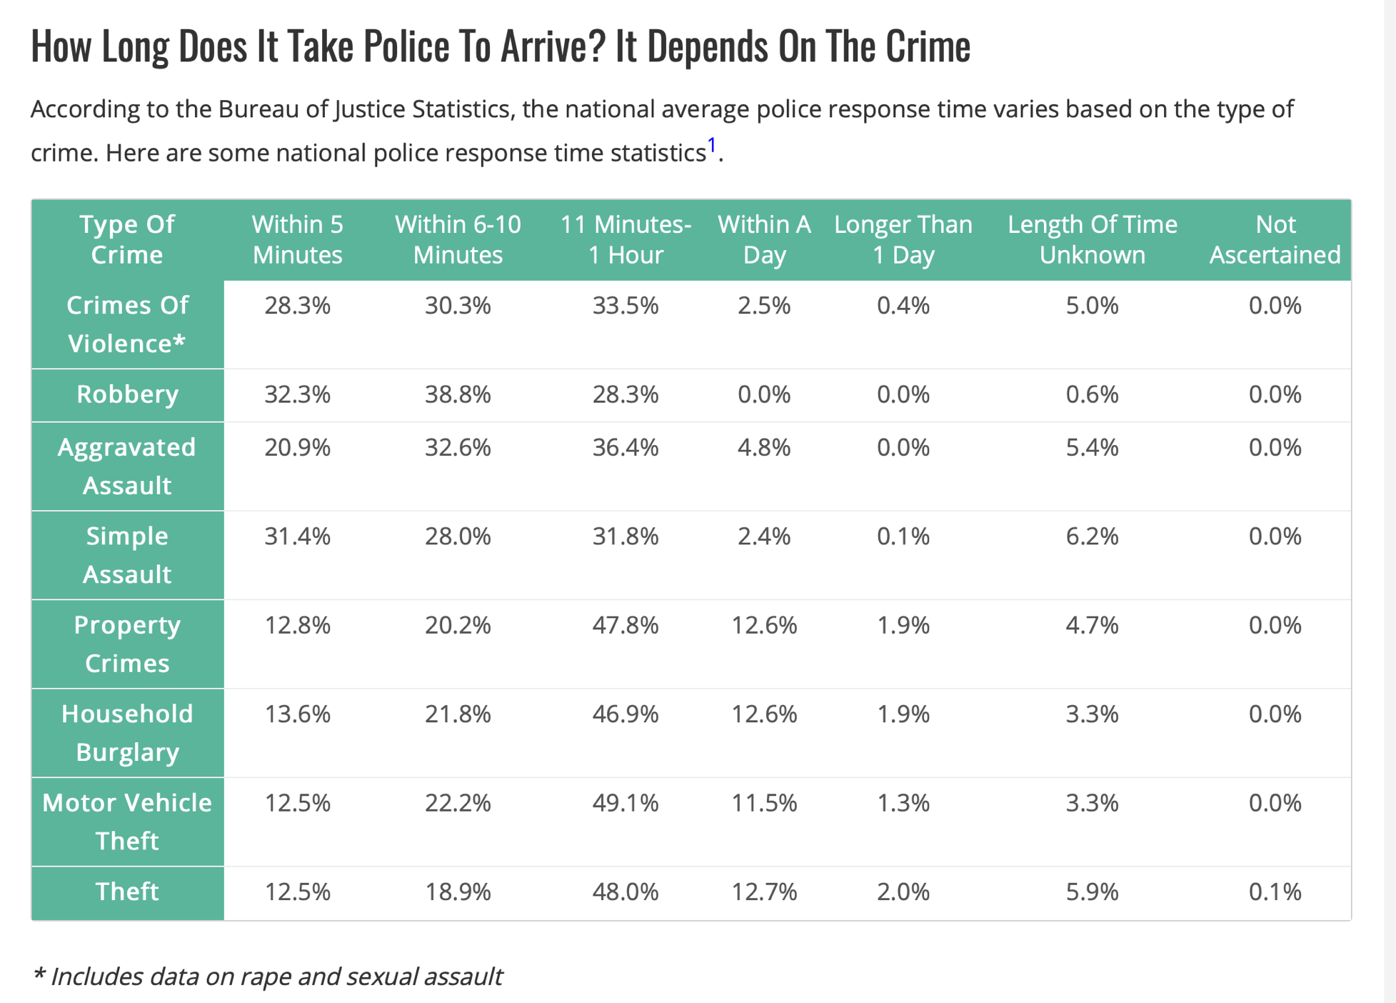
Seconds Count:
”When seconds count, the cops are just minutes away.” American Police Beat reports the average police response time in the US is 10 minutes. Can you survive that long?
C 2019

Slide 7
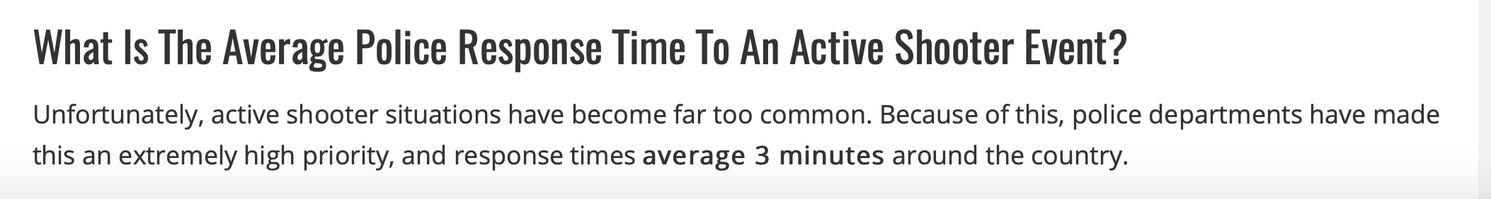
Minutes matter:
According to American Police Beat, the average police response time to an active shooter in the US is 3 minutes, and most active shooting events end before police arrive.
This is not meant to disparage police, but to reinforce the reality that police cannot be everywhere at all times and cannot be expected to be there to protect you. Ordinarily, police arrive after the fact, and can only take a report on what occurred.
The unvarnished truth is that civilians must defend themselves and others, and cannot rely on the police being able to arrive in time to intervene in most violent encounters.
Though police strive to save lives, the fact is that legally armed civilians must be first to act against violence in order to save lives.
C 2019

Slide 8
Civilians in action:
Armed civilians intervening in hostile situations can prevent what would otherwise likely have been mass casualty events:
Birmingham, Alabama, October 27, 2018 – A masked man started shooting in a McDonald’s and was killed by a concealed permit holder.
Titusville, Florida, August 4, 2018 - A gunman at a back-to-school event with hundreds or people present, was shot by a concealed carry holder.
Tumwater, Washington, June 18, 2018 - Three concealed permit holders confronted and killed a man randomly shooting people.
Oklahoma City, Oklahoma, Thursday, May 24, 2018 - Two legally armed men stopped a man who was shooting at patrons in a restaurant.
San Antonio, Texas, December 7, 2017 – A father with a carry permit killed a gunman who tried to shoot the man’s children in a restaurant.
Rockledge, Florida, November 17, 2017 -Two concealed carry holders stopped a shooting at an auto repair shop after a deranged gunman killed one person and injured another.
C 2019

Slide 9
Civilians and Police:
When violence occurs and legally armed civilians respond, these heroic individuals don’t just save other civilians, but often save the lives of police officers in grave danger:
09/13/2018 – Cicero, IL: An officer’s life was saved by a concealed carry holder who shot at a gunman who had wounded the officer.
02/02/2018 – Springville, UT: A concealed handgun permit holder saved a Springville police officer who was being badly beaten.
02/20/2017 – Rising Sun, IN: An officer was saved by a woman from a nearby home who shot and killed the officer’s attacker.
11/15/2016 – Lee County, FL: A motorist with a concealed gun permit shot and killed a man brutally beating a police officer on a highway.
01/16/2016 – Bistro County, TX: A citizen with a carry permit saved an officer from a violent attack by a man who stole the officer’s gun.
01/12/2017 – Tonopah, AZ: An attacker shot and beat an officer, and was then killed by a concealed permit holder who came to his aid.
C 2019

Slide 10
tHE stats:
There are approximately 20 million concealed carry permit holders and nearly 1 million active law enforcement in the US, over one-hundred-million gun owners, and over three hundred million privately-owned guns,
A study ordered by the CDC and conducted by The National Academies’ Institute of Medicine and National Research Council reports that defensive gun uses (DGU’s) by victims are estimated to range annually from about 500,000 to more than 3 million, versus about 300,000 violent crimes involving firearms in 2008.
The same study estimated that there are 1,029,615 DGUs by civilians per year “for self-protection or for the protection of property at home, work, or elsewhere” with an estimate of 162,000 cases per year where someone “almost certainly would have been killed” if they “had not used a gun for protection.” This is in comparison to the 11,208 homicide deaths by firearm in the US in 2012.
These stats show that fifteen times as many people’s lives are saved by legally armed civilians, than die at the hands of armed criminals.
C 2019

Slide 11
The ANSWER:
In order to effect real change and realistically save more innocent lives, a voluntary uniform standard must be established which respects the concerns of the community, while considering the demands on, and capabilities of, law enforcement.
C 2019

Slide 12
THE SAMARITAN NAME:
Meriam Webster Dictionary defines a “good Samaritan” as: a person who helps other people and especially strangers when they have trouble.
A “Program” is defined by Meriam Webster as: a plan or system under which action may be taken toward a goal.
The Samaritan Program is: a system that enables people to help other people when they have trouble so that action may be taken toward the goal of saving lives.
C 2019

Slide 13
THE SAMARITAN LOGO:
The Samaritan Program logo’s symbolism:
The shield represents protection,
Black represents the forces of darkness or evil,
Blue represents law enforcement, and law and order,
The sword represents the fight between good and evil,
The caduceus’ winged snakes, represent medical care.
C 2019

Slide 14
THE SAMARITAN plan:
Anyone who keeps a gun in their home, legally carries a concealed weapon in public, or has one at their place of work will benefit from The Samaritan Program’s combined medical, firearms, communication, and safety protocols.
This standardized formula will be replicated and franchised around the country, providing a broad segment of the population with a valuable baseline of life-saving knowledge.
By appropriately vetting, training, and equipping these good Samaritans, whether civilian or sworn law enforcement, community safety is greatly enhanced, and their own personal safety is greatly improved.
Our goal is to educate all law enforcement and civilians about the life-saving aspects of the Samaritan Program so that every encounter between these segments of society is a safe one.
It only takes a moment for discernment to prevent a tragedy.
C 2019

Slide 15
THE SAMARITAN S.O.P.:
In the simplest terms, The Samaritan Program is intended to teach participants to:
Save Lives
Overcome Threats
Protect Others
C 2019

Slide 16
MISSION Statement:
The Samaritan Program will vet, train, and certify gun owners, concealed carry permit holders, instructors, law enforcement, and everyone desiring to safeguard their homes, workplaces, and communities, to respond to crisis situations in the most effective manner possible, ideally in cooperation with, and in support of, on-duty first responders, in order to safeguard communities.
C 2019

Slide 17
The SAMARITAN SOLUTION:
A vetting process allowing law enforcement to conduct background checks and screen potential Samaritans prior to being accepted into the Samaritan Program training,
A nationwide database which, when queried, provides responding law enforcement with valid identification of the Samaritan so they are immediately recognizable to responding authorities,
A uniform training curriculum enabling civilians and police to be able to interact and understand what is expected of each when they encounter one another while intervening in volatile, hostile situations.
A unique visible indicator readily identifying the Samaritan to others, especially responding police, so the ‘good guys’ know each other,
An open line of communication from the Samaritan to police dispatch identifying the Samaritan and where they are, so the Samaritan can advise the police what they’re wearing, and what they’re doing.
C 2019

Slide 18
The COMPETITION:
There are no known competitors with a standardization model for the training of voluntary civilians on a nationwide scale, in order to enhance community safety.
There are many training facilities and instructors who teach similar curricula, but none that compete against our effort to franchise a standardization model across the country.
Some of these facilities and instructors, if they meet our standards, can become franchised as part of The Samaritan Program.
A sampling of these training entities are:
https://sheepdogresponse.com/sheepdog-level-1/
https://www.gunsite.com
http://www.sheepdogsafetytraining.com/what-we-do/
https://thunderranchinc.com
http://www.stormmountain.com
C 2019

Slide 19
Attitudes:
To gauge the potential receptivity to the concept of The Samaritan Program, we examined recent polling to ascertain the sentiments of the general population, and law enforcement officers (LEO) in particular, with regard to the defensive use of guns to save lives.
C 2019

Slide 20
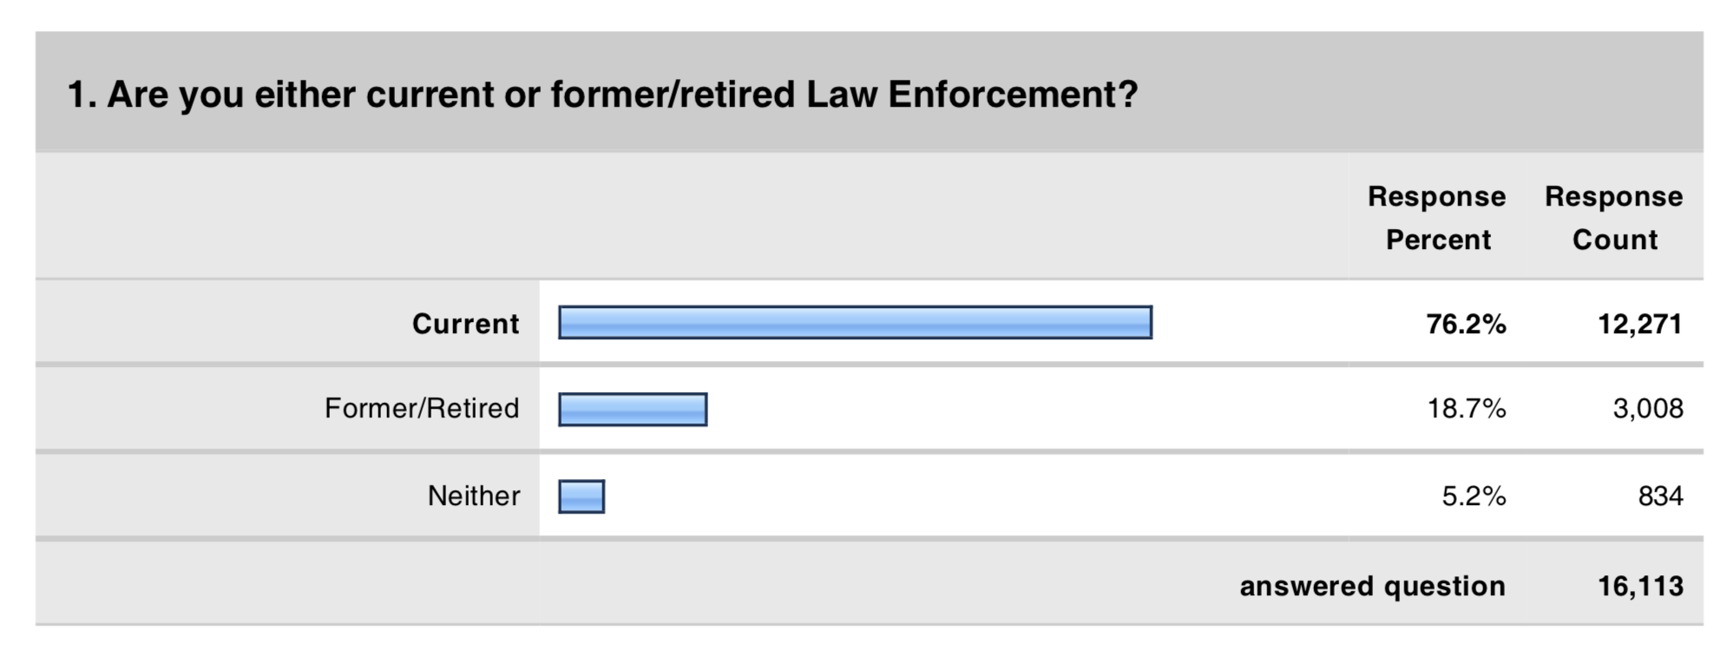
LEO Attitudes:
The largest police poll to date, PoliceOne’s Gun Policy & Law Enforcement survey was conducted March 4 to March 13, 2013, receiving 15,595 responses from verified police professionals across all ranks and department sizes.
C 2019

Slide 21
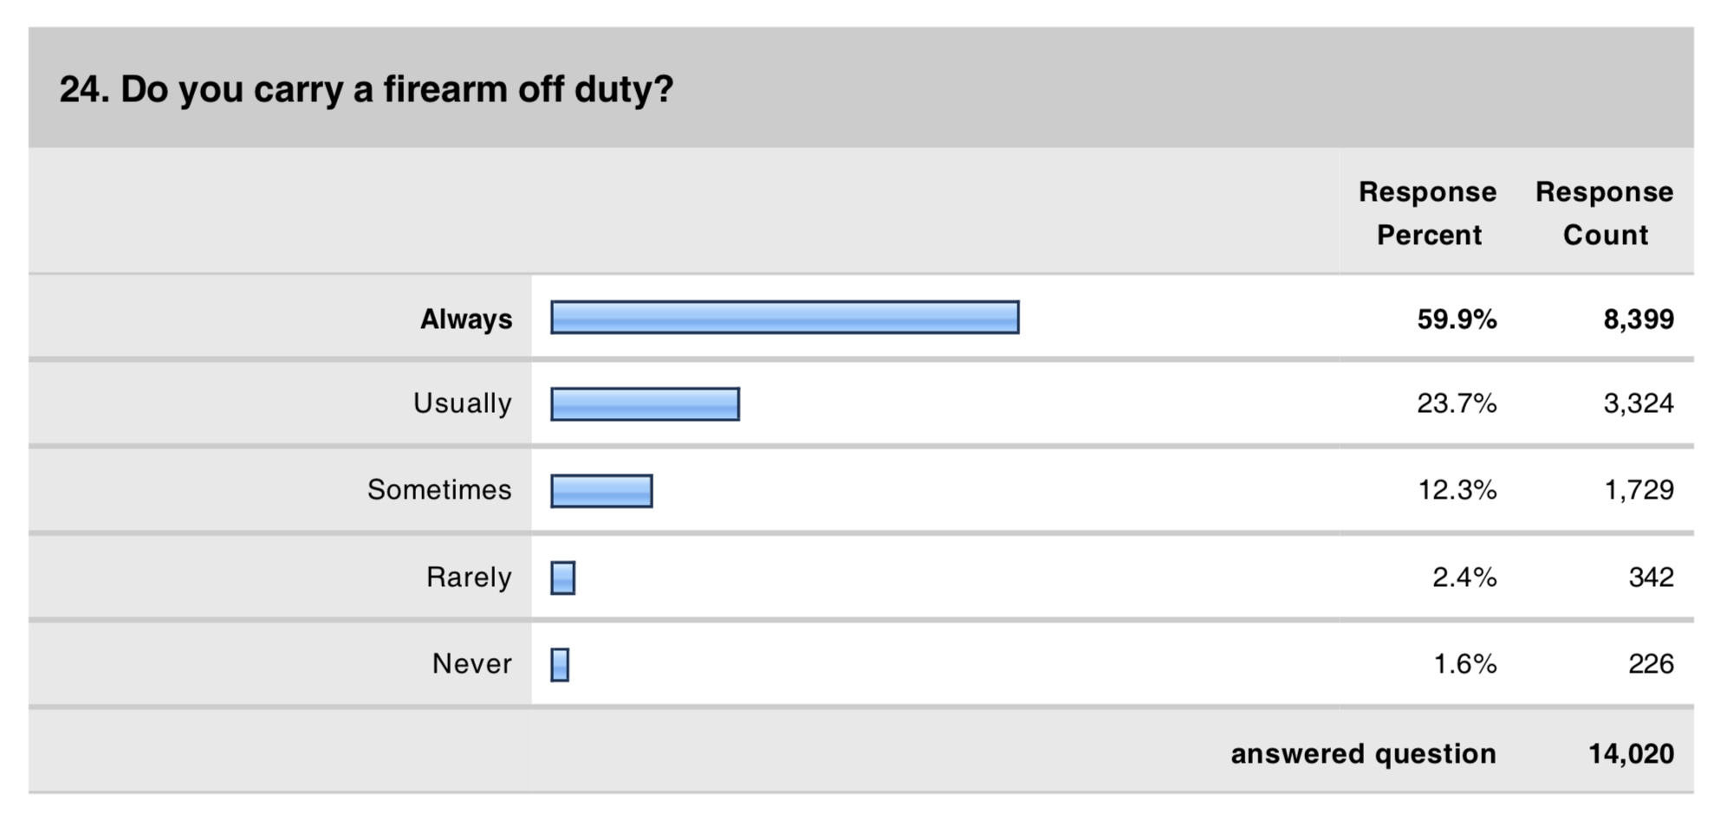
LEO Attitudes:
PoliceOne’s Gun Policy & Law Enforcement question on whether the respondents carry a gun off duty. Of 14,000 responses, 83.6% say they carry a gun always or usually.
C 2019

Slide 22
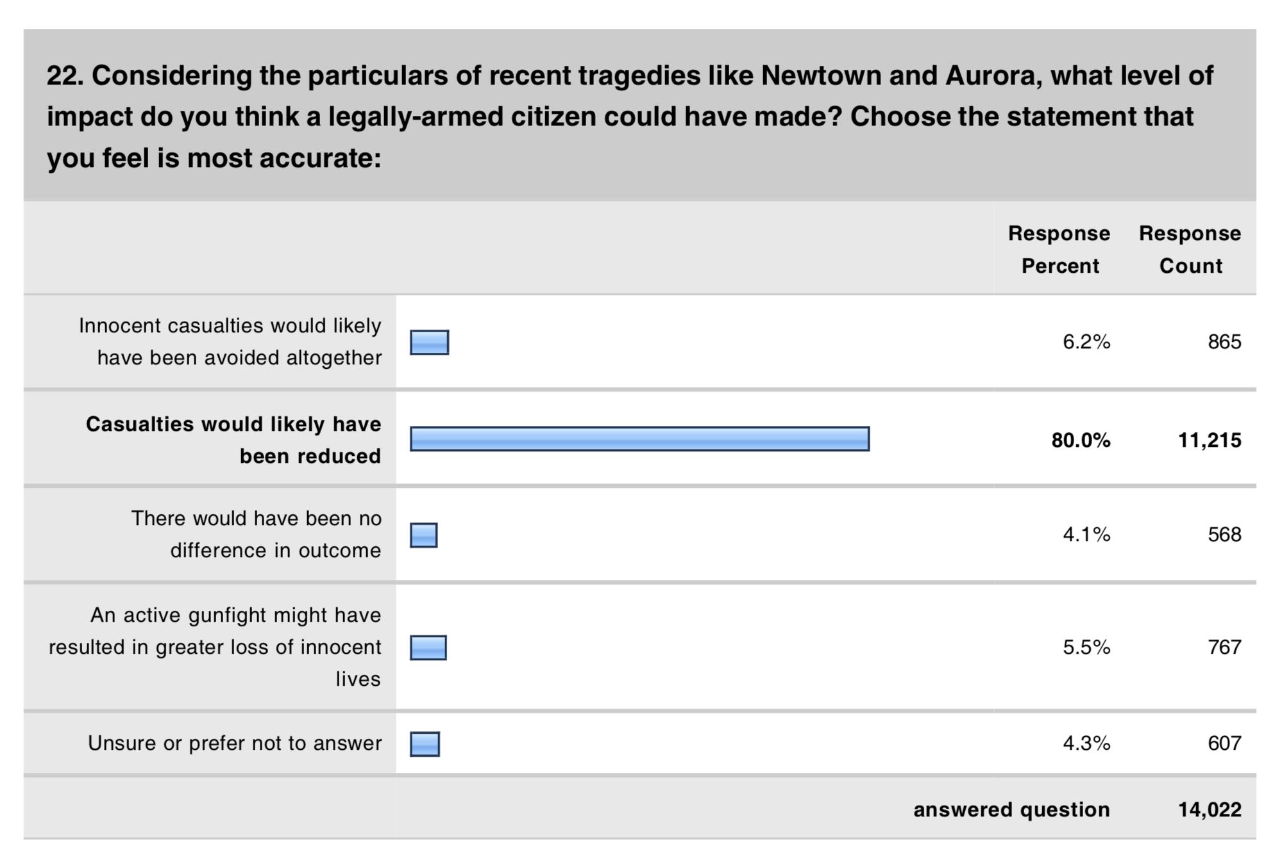
LEO attitudes:
PoliceOne’s Gun Policy & Law Enforcement question on legally armed citizens stopping mass shootings. 86.2% said casualties would be reduced or avoided altogether.
C 2019

Slide 23
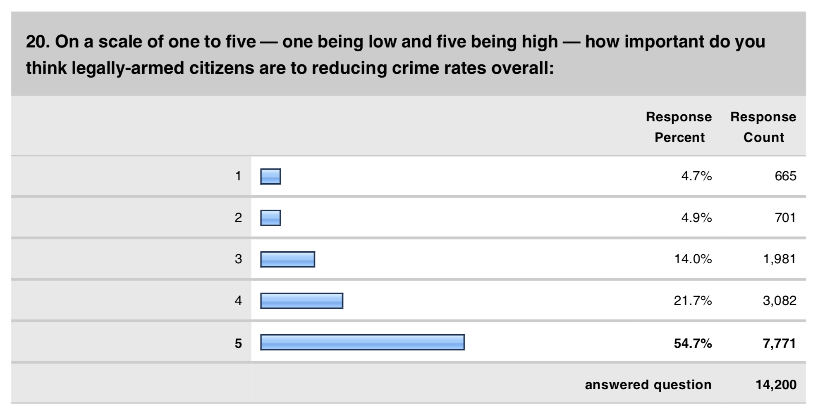
Leo attitudes:
PoliceOne’s Gun Policy & Law Enforcement question on how important legally armed citizens are to reducing crime. 76.4% respond positively in the top two categories.
C 2019

Slide 24
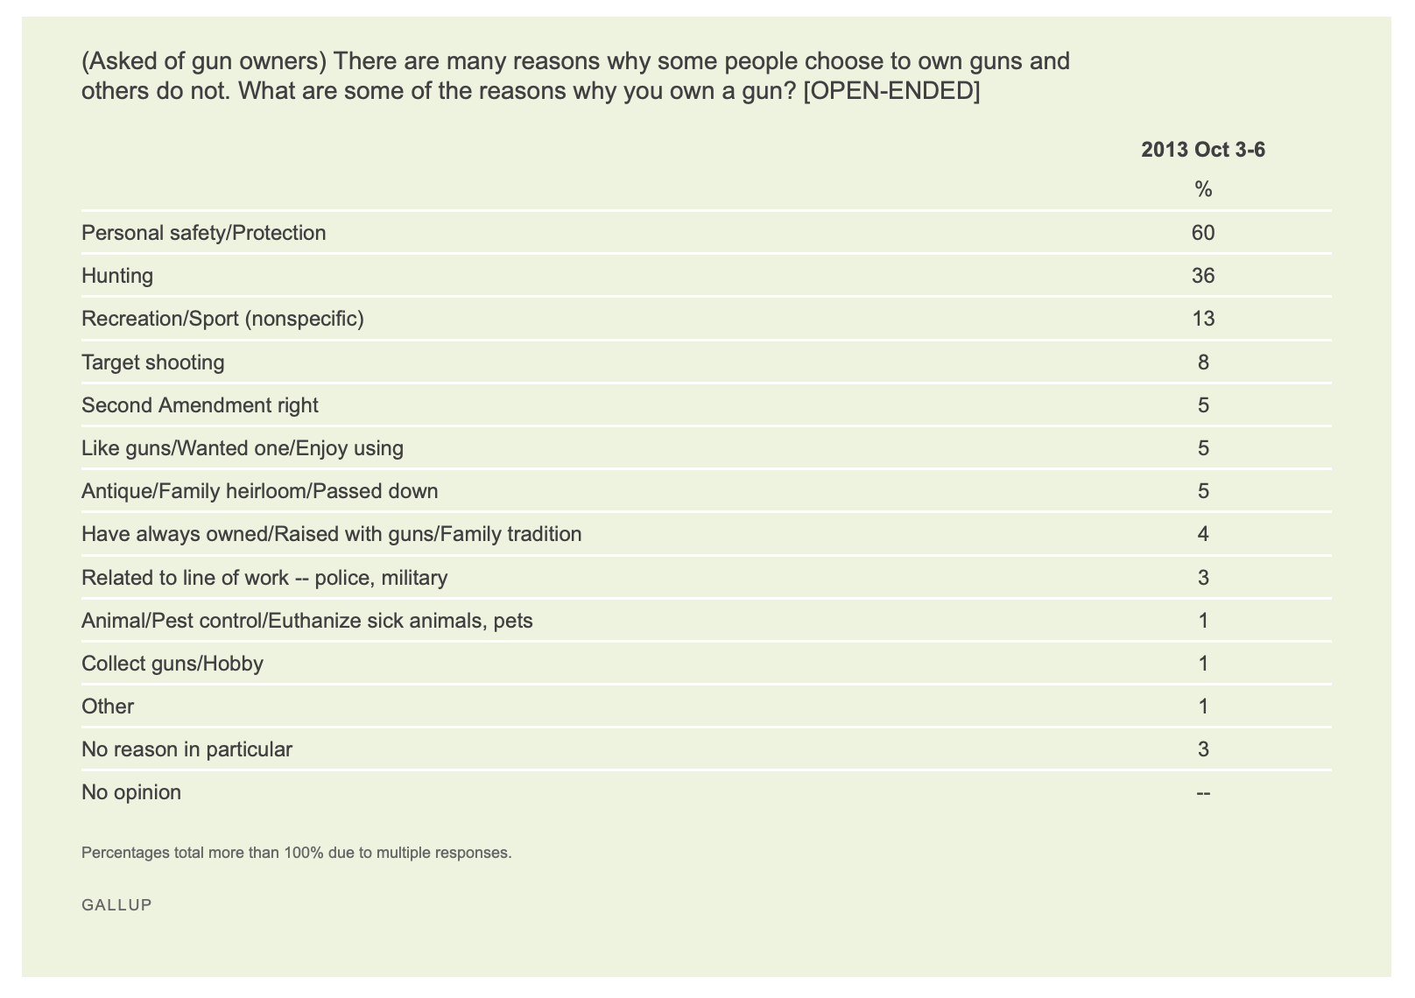
Public attitudes:
Gallup poll of gun owners on why they own a gun.
A majority (60%) answered “Personal safety/Protection”
C 2019

Slide 25
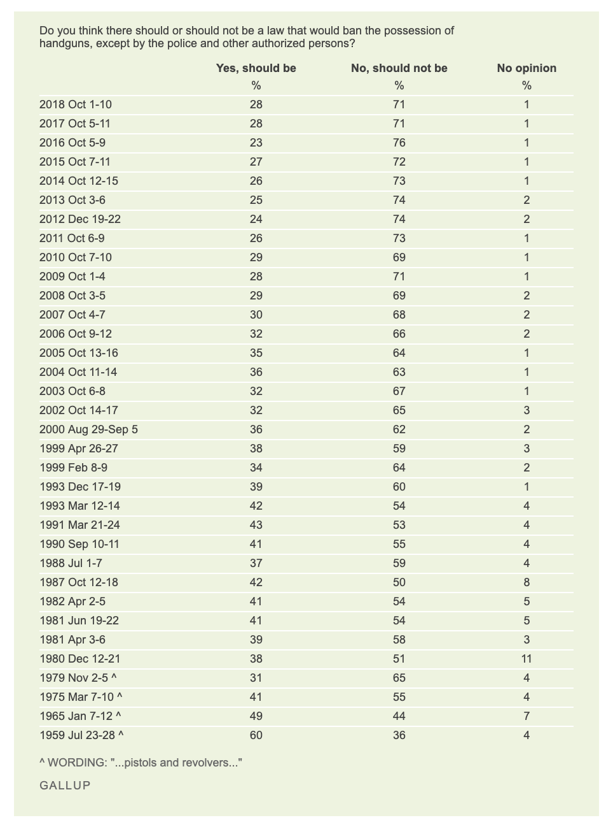
Public attitudes:
Decades of Gallup polling on whether private handgun ownership should be banned, allowing only the police to have guns.
Recent year’s results show a vast majority of respondents (71%) said: “No”
C 2019

Slide 26
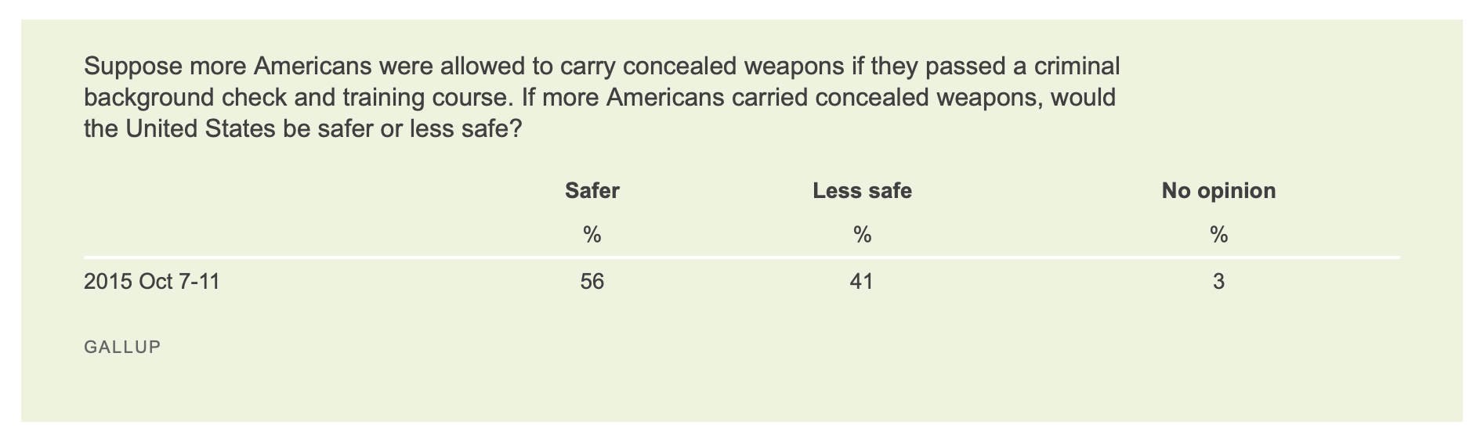
Public attitudes:
Gallup polling question of gun owners on whether more people carrying a concealed weapon would make America safer or less safe.
A clear majority (56%) believe it would make the US safer.
C 2019

Slide 27
Attitudes Summary:
What is clear from our examination of recent polling is that a large majority of police officers – the segment of society most acutely aware of the problem of violence today - enthusiastically support private citizens owning and carrying guns in public as a means of reducing crime and increasing community safety. Though by a smaller margin, the majority of the general public also share that view.
C 2019

Slide 28
PARTNERS:
The Samaritan Program has initiated partnerships with an elite group of manufacturers and thought leaders in order to provide the best available products and solutions to confront and overcome threats to community safety.
C 2019

Slide 29




SAMARITAN PARTNERS:
XG Productions’ former FBI, police, prosecutors, criminal experts, and highly-skilled production, development, and marketing professionals in an exceptional Hollywood production company.
Gun Digest is the renowned elder stateman in the realm of firearms related publications, with seventy-five years in print and an expanding digital presence it is uniquely suited to convey relevant firearms related information to a broad audience.
Recoil Magazine/TV is a contemporary publication/content venue for the modern shooting enthusiast, which is known as “the ultimate firearms destination for the gun lifestyle.”
Combatics Training is a truly unique facility that prepares individuals and groups to effectively act to save lives in unexpected combat wherever and whenever it might occur.
C 2019

Slide 30


SAMARITAN PARTNERS:
De Santis Gunhide is one of the largest holster manufacturers in the world, and has joined the Samaritan Program to design custom concealment products for civilian and off-duty LEOs.
North American Rescue is dedicated to decreasing preventable death by providing the most effective/highest quality mission critical medical products to military, police, and civilian life savers.
RECOIL’s Concealment is the one source for the concealed carry lifestyle, allowing those interested in, or already legally carrying a gun, to be better informed about carrying a firearm for protection.
T-WORX is an innovation leader in smart technology, power supply, and communications systems for military, law enforcement, and civilian applications, creating cutting-edge “smart-weapons”.
T-WORX
C 2019

Slide 31
THE BOARD:
Until now there has not been a recognized accreditation body responsible for the certification of competency, authority, or credibility for a nationwide community safety protocol with regard to the legally-permitted concealed carry population.
Though states and regional governments determine local standards, and the NRA and FTA certify individual instructors, there is no nationally recognized body that sets a voluntary uniform standard across all fifty states for those who legally bear arms.
In the absence of such a body, The Samaritan Program’s Advisory Board was assembled to fill this void and establish the specifications for the nationwide standard of training and the processes required to implement this national-level community safety regimen.
This board is the accreditation body, and is comprised of a diverse array of dozens of concerned civilians, concealed carry holders, active and retired law enforcement, business people, and emergency medical first responders, from throughout the United States.
C 2019

Slide 32
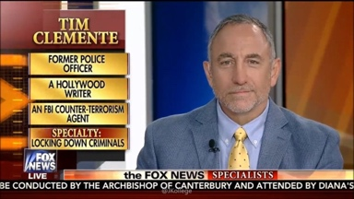
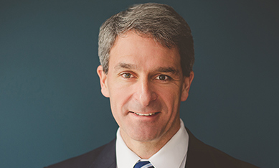
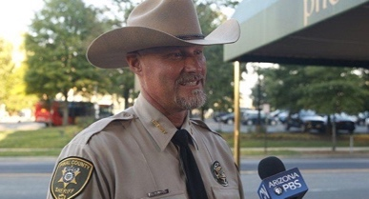
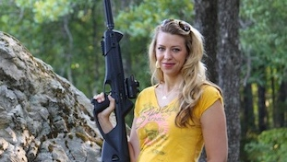
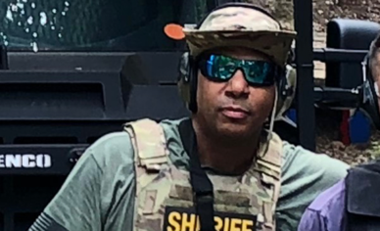
THE SAMARITAN BOARD 1:
Tim Clemente, a former St Louis Metro PD officer, FBI Agent, SWAT operator, and FBI certified Firearms /Tactical Instructor, now operates a firearms training facility in rural Virginia.
Ken Cuccinelli, Virginia's 46th Attorney General (2010-2014), is on the board of the Law Enforcement Legal Defense Fund, protecting LEO’s wrongfully charged with crimes while protecting the public.
Sheriff Mark Lamb is the top law enforcement officer in Pinal County, Arizona, who has come to be known by the moniker: “American Sheriff”, and is known for his from-the-front leadership style .
Natalie Foster, the founder of Girl’s Guide to Guns, is a wife, mother, NRA Advocate and shooting sports enthusiast who was raised in Texas, and currently resides in Southern California.
Paul Castilho Kelley is an RN and a Paramedic Critical Care Trauma Specialist, and a Deputy Sheriff with Westchester County, NY Sheriff’s Department, with Tactical Medical certifications.
C 2019

Slide 33
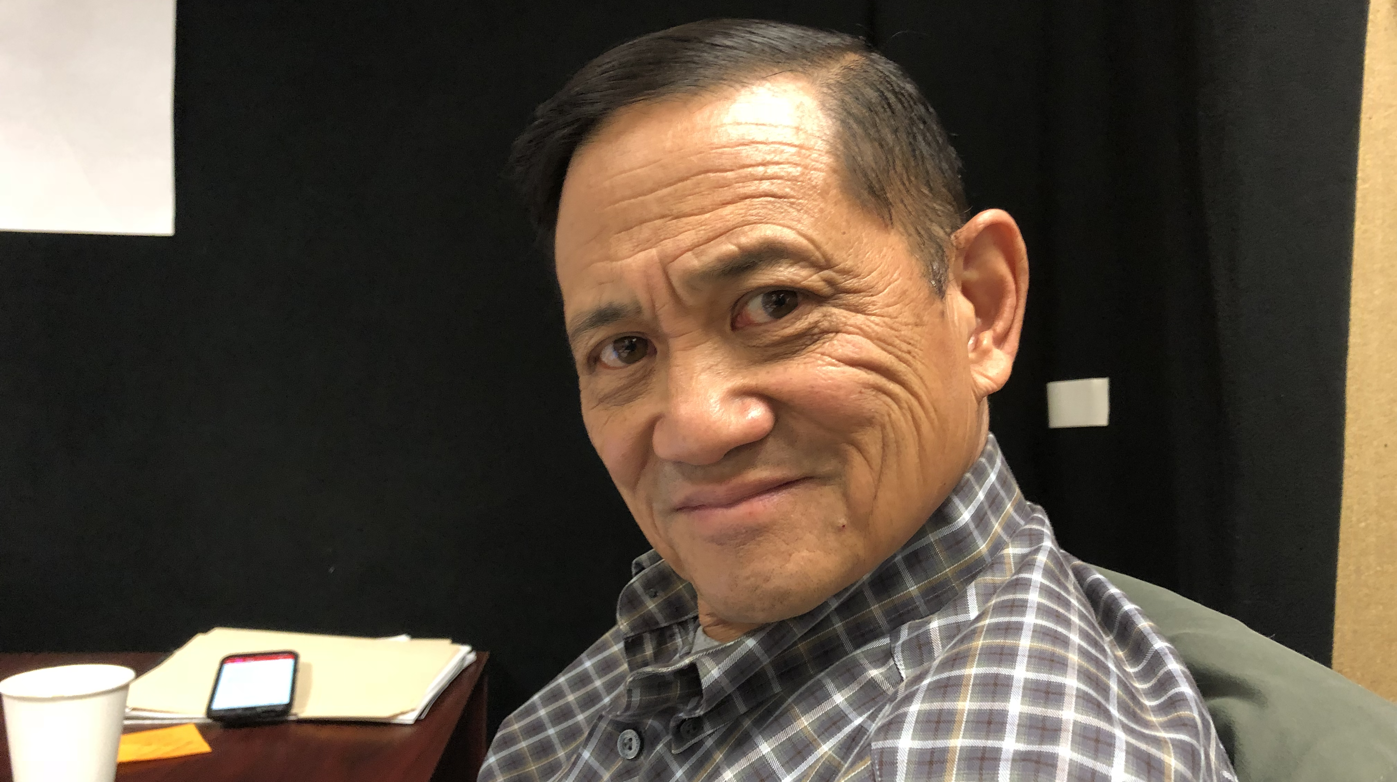
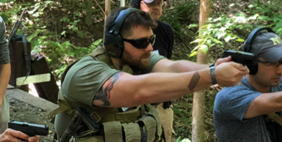
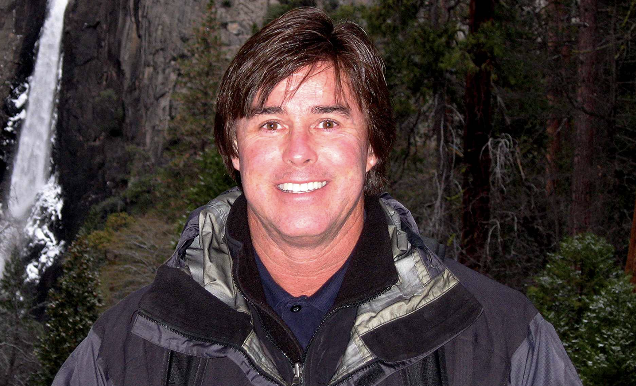
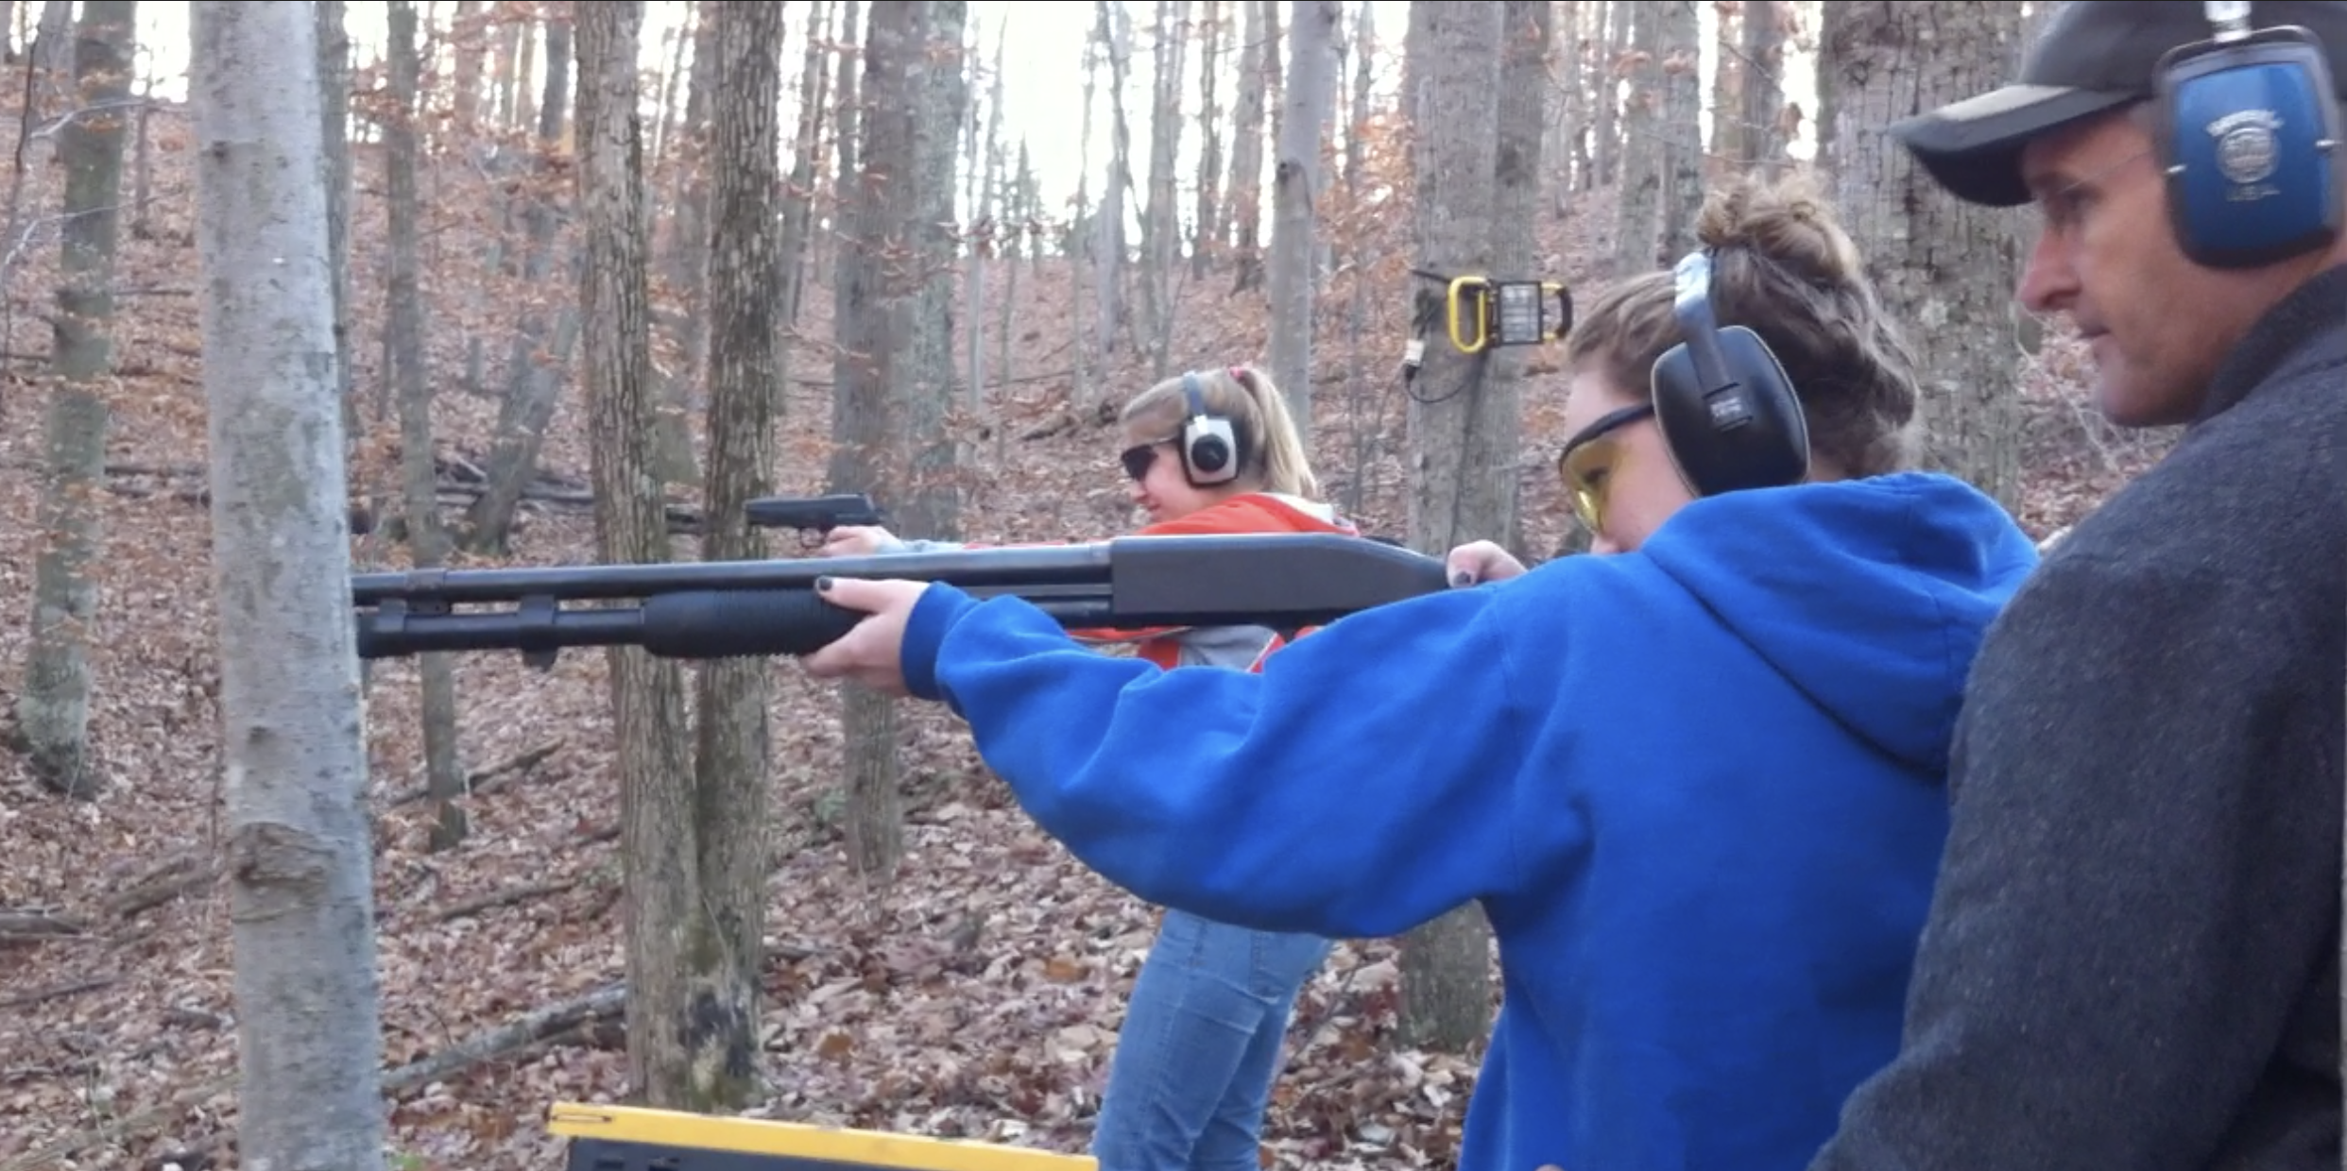
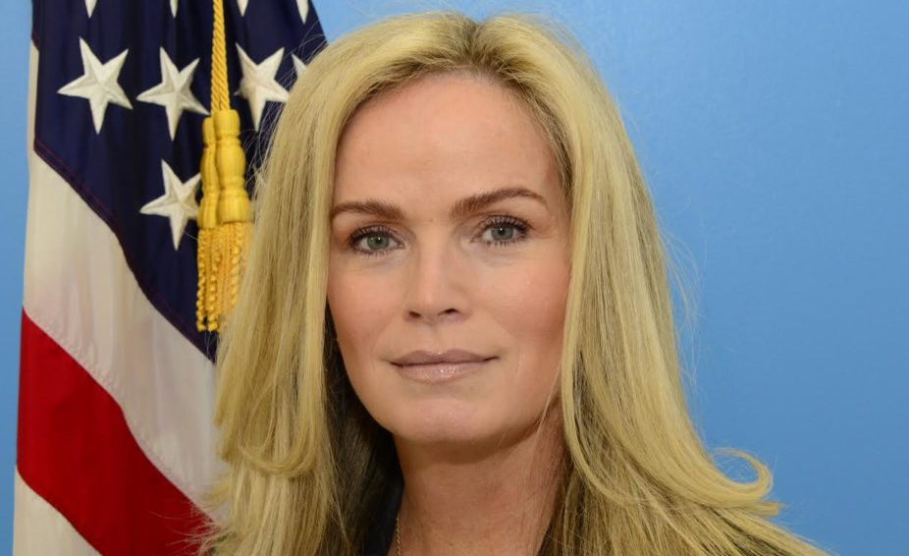
THE SAMARITAN BOARD 2:
Lance Woo is a graduate of Stanford University, holds a Master’s in Criminal Justice Administration, served 39 years in the FBI, and is an FBI Firearms Instructor in Los Angeles.
Mason Robertson is a former Marine, firearms expert, and training curriculum programmer, with a wide range of experience in military and civilian weapons systems, who resides near Quantico, Virginia.
Tom Elliott is a renowned Hollywood stunt man who has performed in hundreds of iconic movies and TV shows, and holds a License to Carry a Concealed Firearm in California.
Tom Lawn retired from the Fairfax County Police Department after 20 years of service, and is now an investigator with the Stafford County Sheriff’s Department, and is also a firearms instructor.
Maureen O’Connell, a 25-year FBI veteran, owns a security consulting business in Los Angeles, and is national president of the FBI’s InfraGard program, protecting the US’ critical infrastructure.
C 2019

Slide 34
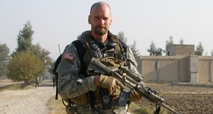
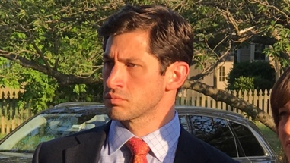
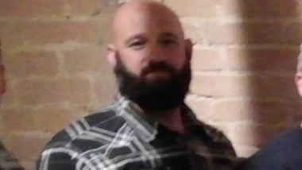
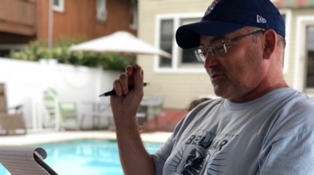
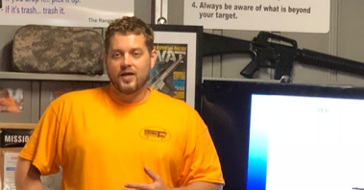
THE SAMARITAN BOARD 3:
Carson Ulrich is the most highly decorated Federal Agent in the history of the US Department of Justice, served for 25 years as a DEA Agent and is a Firearms/Tactical Instructor in Virginia.
Chris Galvan is a training systems analyst for a defense contractor who holds a Top Secret national security clearance, is a firearms enthusiast, and is a concealed carry permit holder in Virginia.
Brandon Brown is a police officer and paramedic from South Carolina who supplies state-of-the-art life-saving medical products to law enforcement and emergency medical personnel.
Bernie Flynn, Esq is the former CEO and General Counsel of New Jersey’s largest insurance firm, and is a widely regarded expert in the fields of risk management and public policy.
Trent O’Brien is a former Australian Federal Police officer, United Nations personnel security expert, and firearms/medical instructor with advanced paramedic certifications, residing near Richmond, VA.
C 2019

Slide 35
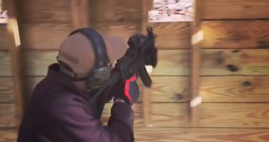
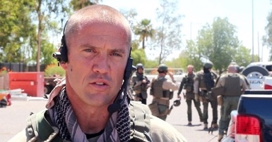
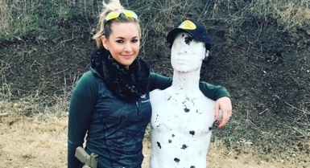
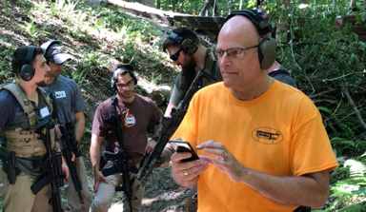
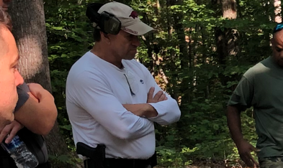
THE SAMARITAN BOARD 4:
Joshua Clemente is a mechanical engineer experience in tactical and aerospace industries, is an avid shooter and a concealed carry permit holder, residing in Philadelphia, PA.
Chief Deputy Matt Thomas with the Pinal County Sheriffs Dept has extensive violent crimes experience, was a SWAT operator, and is an adjunct instructor at the Regional Police Academy in Arizona.
Katie Pavlich is a respected journalist, author, and television personality in Washington, DC, who is also a firearms enthusiast, and a concealed carry permit holder.
Tom Ohmer, a retired police officer who served with the LAPD and Simi Valley, CA Police Departments, is an NRA certified firearms instructor, and holds a concealed carry permit in Florida.
Josh Beckham, former US Navy enlisted, is a systems engineer & integrator for over 35 years in defense and commercial applications, a father, gun hobbyist who has a concealed carry permit in Virginia.
C 2019

Slide 36
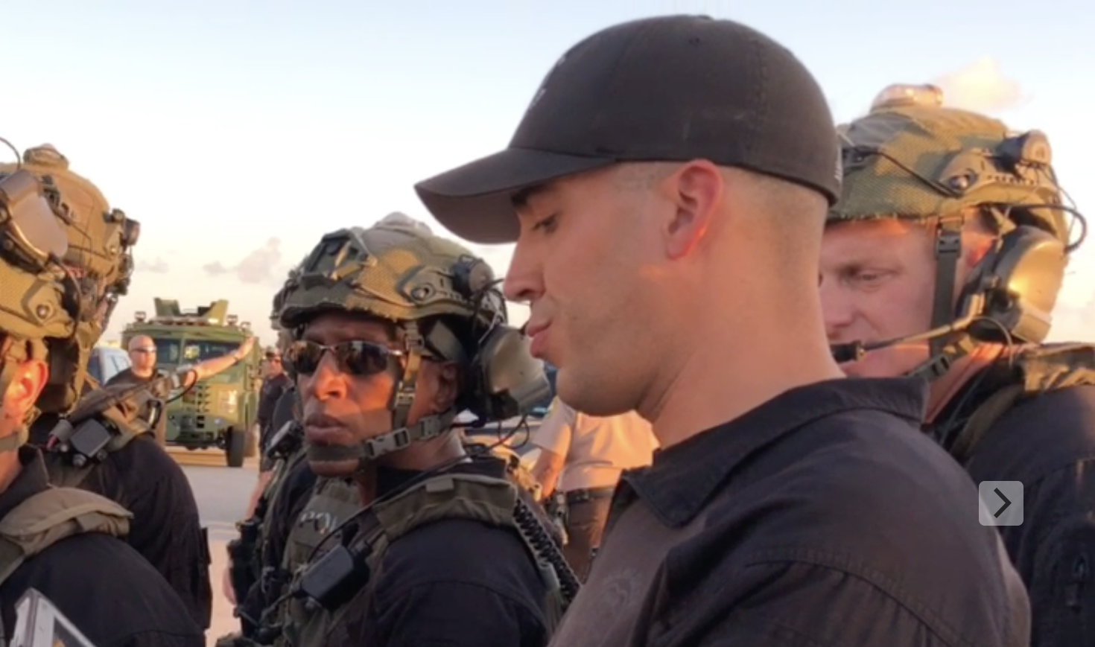
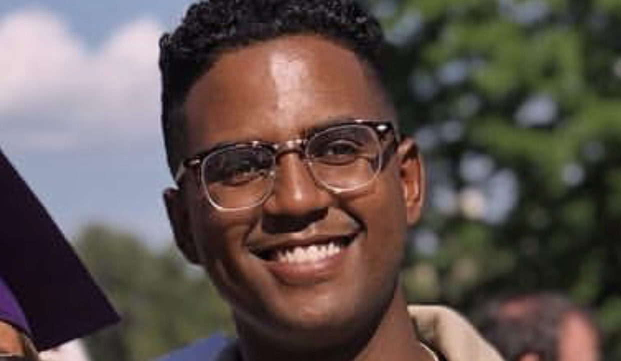
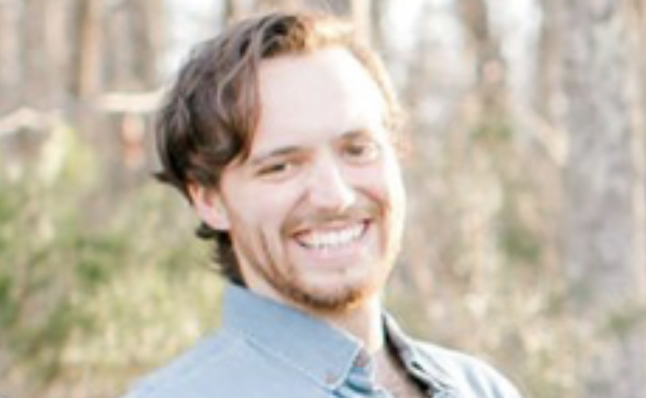
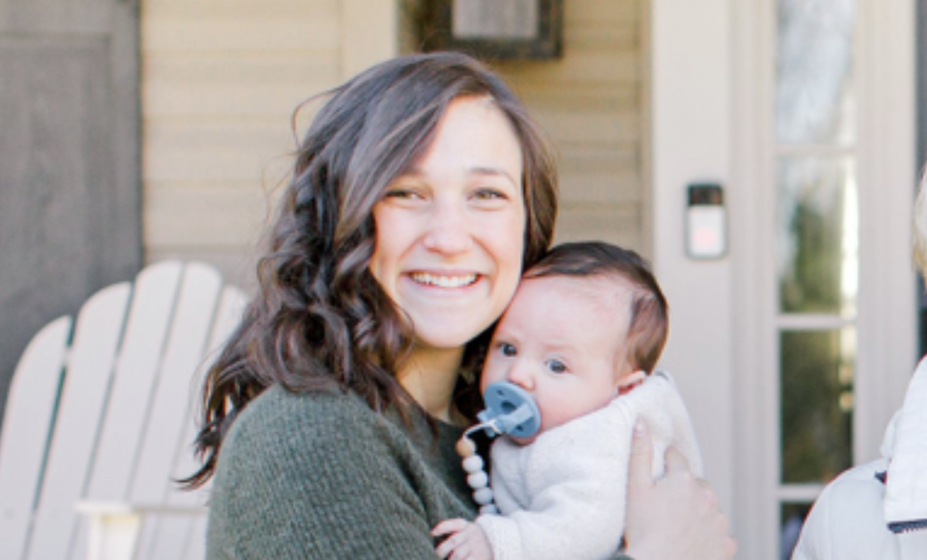
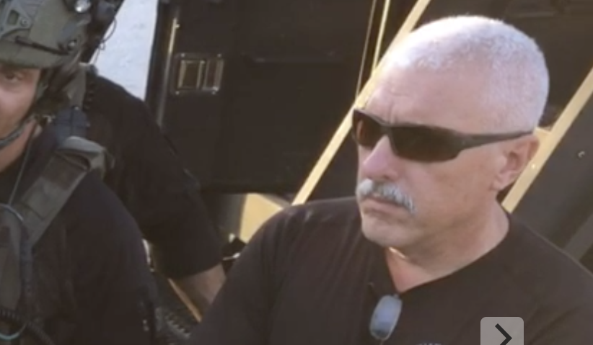
THE SAMARITAN BOARD 5:
Lieutenant Francis Rego is the commander of the Miami Dade Police Department Special Response Team (SRT), which is a full-time SWAT team covering the Miami region.
Ayman Mohamed’s background is in computer information systems as a govcon software developer in the Washington, DC area, and is part of the community outreach effort for The Samaritan Program.
Peter Corvetti is a husband, father, and concealed carry permit holder in the Charlottesville, VA area, who is part of the operations support staff for The Samaritan Program.
Kateri Corvetti is a wife, mother, and concealed carry permit holder in the Charlottesvile, VA area, who is part of the community outreach effort for The Samaritan Program.
Robert “Buck” Perez is a retired senior team leader of the Miami Dade Police Department’s SRT Team, was one of the team’s longest serving members and lead instructor.
C 2019

Slide 37
Curriculum:
The Samaritan Program’s life-saving training curriculum includes relevant medical skills and firearms tactics and methods that have been compiled by our in-house advisory team of medical, law enforcement, firearms, and tactical experts.
C 2019

Slide 38
PROGRAM OBJECTIVES:
The Samaritan Program empowers volunteers with the skills and tools needed to assess and effectively react to life-threatening situations with the greatest opportunity to prevent loss of life, and help others.
The Samaritan Program’s unique standardized vetting, certification, and accreditation process, in coordination with local, state, and federal law enforcement and first responders, ensures its graduates are assets, not liabilities, for public safety professionals.
The Samaritan Program’s proprietary rapid visual identification and communication system will be immediately recognizable to other civilians and to responding public safety officials, reducing the possibility of blue-on-blue tragedies.
C 2019

Slide 39
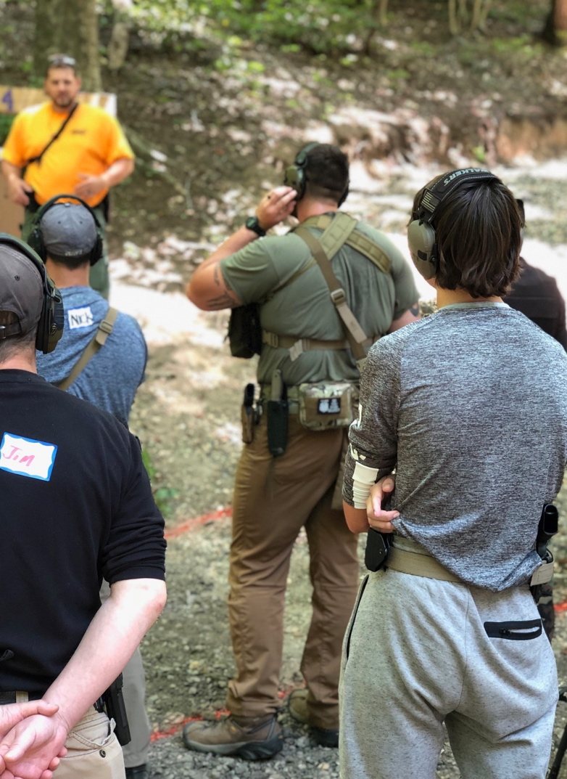
TRAINING STANDARDS:
The Samaritan Program imparts life-saving skills that are paramount to the proper application of related medical competencies, and the effective, responsible use of firearms in defense of self or others, such as:
  Appropriate Mindset
  Advanced Bleeding Control
  Concealed Carry Practices
  Under-Stress ID and Communication
  Instinctive Shooting
  Effective Solo Movement and Cover
  Multi-Person Movement
  Crisis Response
  Safety Third
C 2019

Slide 40
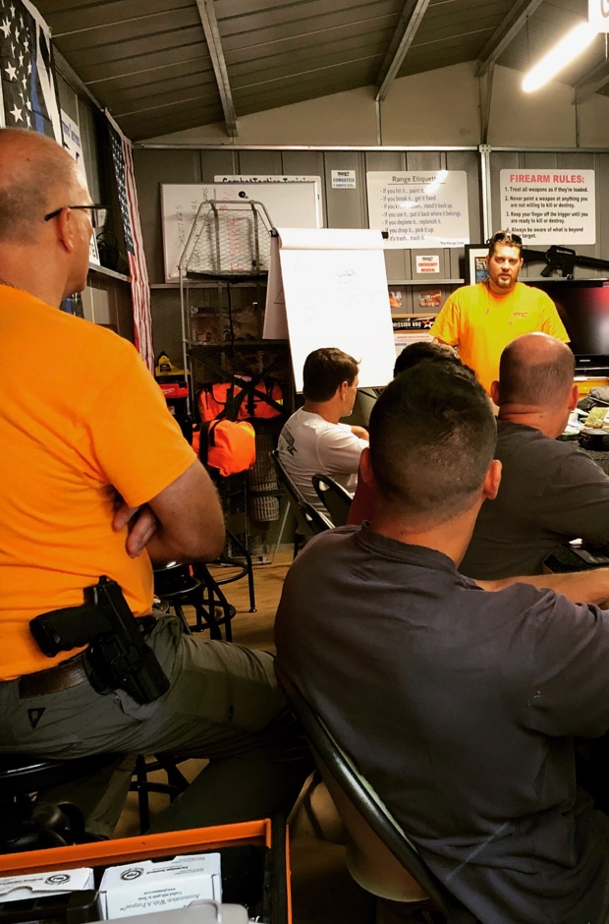
TRAINING BREAKDOWN:
In order to properly quantify the level of achievement by Samaritan Program students, the following protocols are used:
Each of the requisite Skills are broken down into Tasks, in order to make them easier to train and to qualitatively evaluate.
Multiple Tasks must be trained, performed, and evaluated to be considered proficient in a Skill.
All of these standards will be maintained for the certification of instructors and trainers, and the students themselves.
C 2019

Slide 41
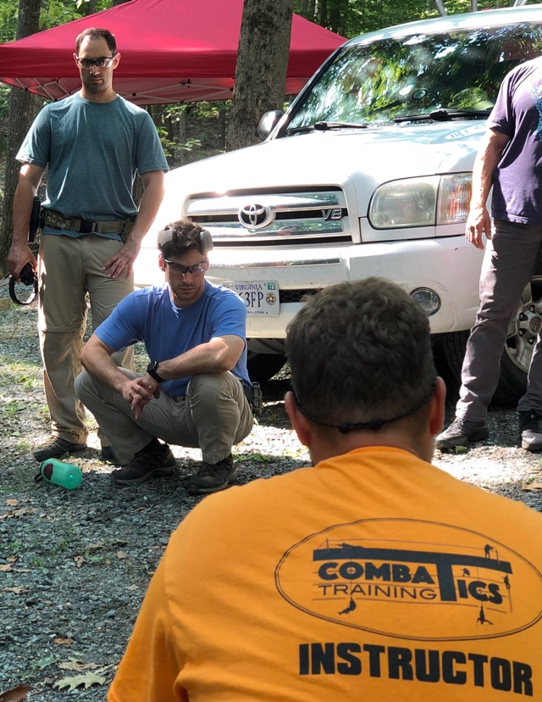
SAMARITAN MINDSET:
Anyone who owns or carries a weapon could find himself needing to use it, and or deal with the aftermath of its use, and should therefore be trained and prepared to use a gun effectively, and have the medical skills needed to save lives.
Requisite Tasks:
  Understand the ‘Three Conflicts Rule’ and seriously consider Conflict #1,
  Understand the physiological effects and responses to stress,
  Demonstrate the willingness to fill whatever leadership or support role is needed in a crisis situation,
  Assess and communicate an accurate brief of your capabilities and or deficiencies.
C 2019

Slide 42
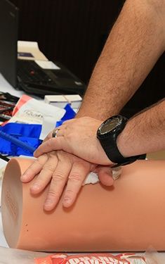
SAMARITAN MEDICAL:
Anyone who owns or carries a weapon must be prepared to deal with the consequences of his own, or a strangers’ trauma-related bleeding.
Requisite Tasks:
  Locate source of bleeding: entry wound, exit wound, or both,
  Properly apply tourniquet to extremity in less than 35 seconds,
  Demonstrate ability to effectively pack and treat a penetration wound to stem blood loss using hemostatic agents or bandages,
  Effectively communicate level of injuries to Police, EMS, or rescue personnel within a realistic scenario.
C 2019

Slide 43
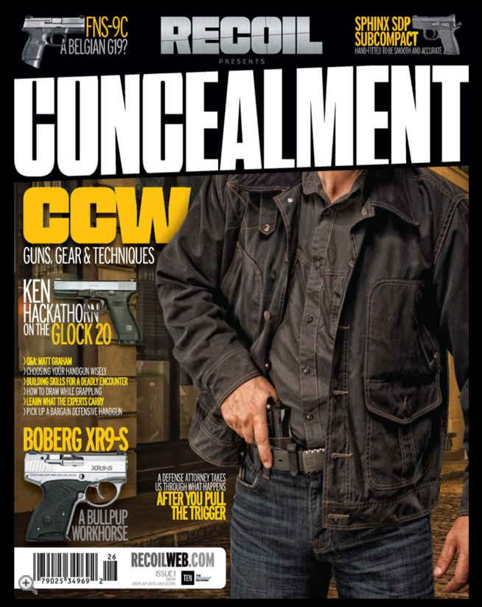
CONCEALED CARRY:
Legally carrying a concealed weapon in public comes with inherent risks and consequences:
Requisite Tasks:
  Know/understand federal, state, and local laws,
  Understand the fundamentals of carrying the right gun in the right manner so as to be most effective with it when you need to be,
  Be disciplined with regard to continuous training and practice with the gun and the concealment system so that deployment becomes instinctual,
  Learn to identify indicators and warnings of a potential threat, and how to properly respond via appropriate escalation of force,
  Dress for Success; understand the importance of limiting “printing” or protrusion of the weapon through clothing, to maintain element of surprise.
C 2019

Slide 44

STRESS COMMUNICATION:
Reaction to stress can adversely affect even menial skills. Dealing with those effects is paramount.
Requisite Tasks:
  Demonstrate the ability to verbally and visually communicate that you are not a threat, prior to revealing you have a weapon,
  Demonstrate the ability to convey clear, precise statements of fact and directions to the public and first responders in threat-based scenarios,
  Effectively convey accurate information about the threat - no theories - only pertinent facts,
  Adapt to the appropriate course of action based on evolving scenarios, and the input and presence of others and authorities.
  Demonstrate the ‘Third Conflict’ rule by accurately recounting the events after the fact.
C 2019

Slide 45
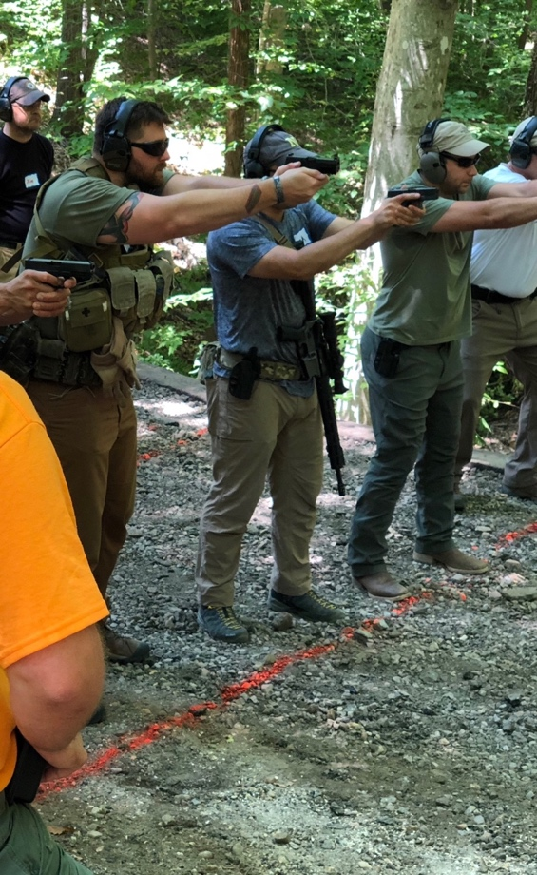
INSTINCTIVE SHOOTING:
Develop the fundamentals of accurate point-shooting in close-confine shooting scenarios, which provides faster target acquisition and center-mass accuracy at 3 to 10 yds than sight-based training.
Requisite Tasks:
  Maintain focus on the immediate threat, and your surroundings, not just on the gun’s sights,
  Effective muzzle-control and trigger discipline,
  Establish correct stance/grip: square to target, knees bent, dominant leg rear, shoulders forward, arms extended, 70/30 grip,
  Drawing from concealment: eyes on threat, clear clothing, presentation from the low-ready to high-ready, engagement without losing threat focus or periphery awareness.
C 2019

Slide 46
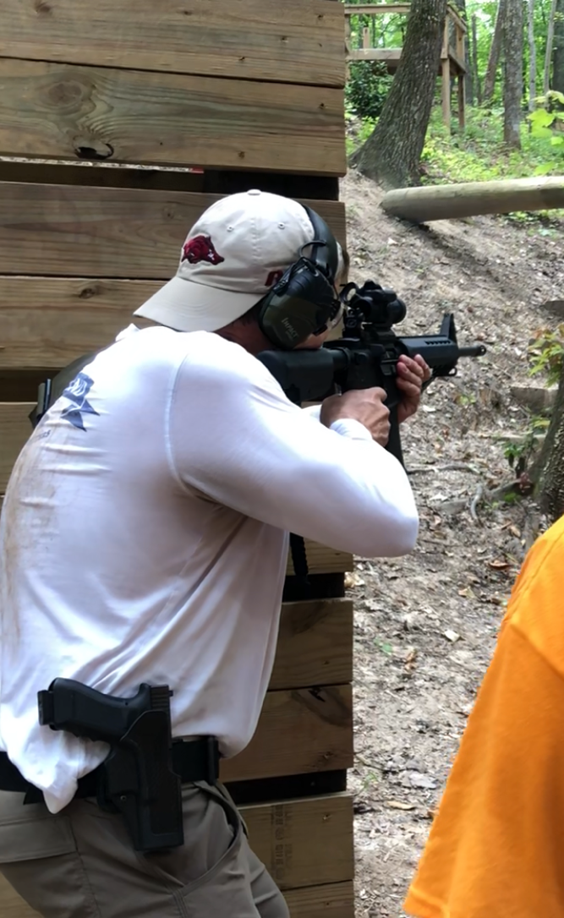
MOVEMENT & Cover:
Combat situations require combat tactics, not static, shooting-range tactics: the world is not flat, so a good firearms training regimen should not be.
Requisite Tasks:
  Understand and demonstrate the difference between concealment and cover, and effectively utilize both in realistic scenarios,
  Demonstrate the use of concealment to maintain the element of surprise, and cover as protection from hostile fire,
  Affect proper movement between positions of cover while minimizing vulnerability, and maintaining awareness,
  Accurately engage threats from a covered position, or while on the move, not from out in the open, unless impossible to do otherwise.
C 2019

Slide 47
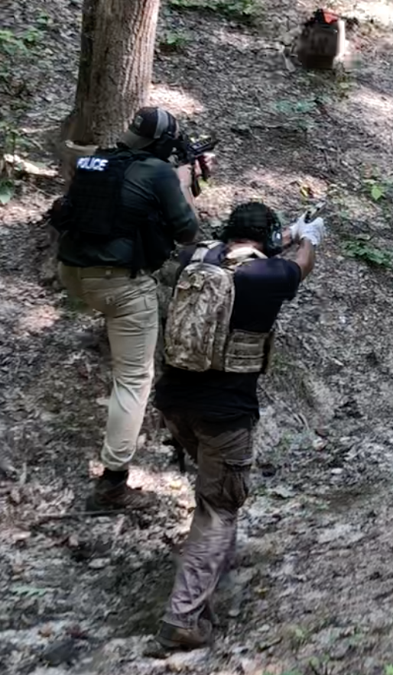
TEAMING UP:
Responding to a threat in a public setting requires interaction and cooperation with people unknown to you.
Requisite Tasks:
  Understand the dynamics of multi-person (team) operations, and coordinated action with strangers,
  Effectively use verbal and non-verbal communication in situations where sound-discipline is paramount,
  Affect proper movement with others, between positions of cover while minimizing exposure and maintaining muzzle and trigger discipline,
  Understand and exemplify The Samaritan Program as a baseline for trust between you and others,
  Communicate and divide responsibility with others to maintain 360 degree awareness and security,
  Triage and treat others who are isolated, trapped, or injured, while covering one another in the process.
C 2019

Slide 48
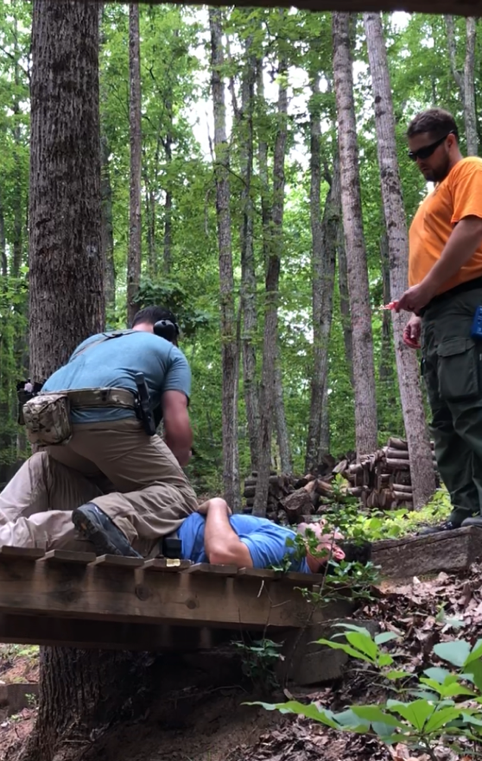
CRISIS RESPONSE:
Anytime a hostile threat presents, crisis response is required, from the public as well as first responders.
Requisite Tasks:
  Successfully undergo scenario-based, problem-solving training iterations designed to induce the high levels of stress encountered in life-or-death situations,
  Assess and identify others as a liability, asset, or unknown quantity in a given scenario, and decide how to work together to save others,
  Properly prioritize victims based on wound trauma, and triage multiple simultaneous threats and victims in a given scenario,
  Maintain 360-degree situational and sensory awareness during given scenarios, and avoid tunnel vision.
C 2019

Slide 49
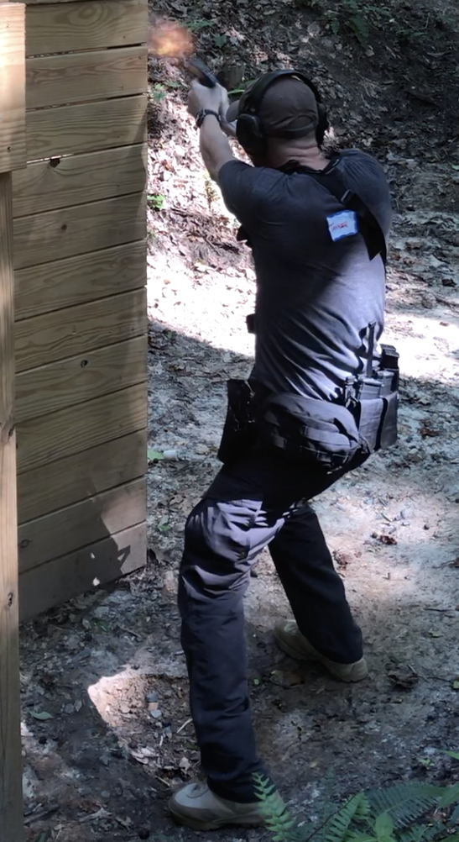
SAFETY THIRD:
Aversion to unnecessary risk has recently evolved into an unfortunate “take no risks” attitude, which can have the unintended consequence of putting lives at greater risk.
Requisite Tasks:
  Prioritize and evaluate a life-or-death situation to:
    Save Lives
    Overcome Threats
    Protect Others (then Yourself)
  Personal safety cannot be the primary objective,
  Staying safe means not risking your own safety to eliminate the threat or save other’s lives.
  Someone must act, must put himself at risk.
  Someone must lead, must go first. Who?
  “The only thing necessary for the triumph of evil is for good men to do nothing.” Edmund Burke
  “Safety Third” slogan attributed to Mike Rowe
C 2019

Slide 50

SAMARITAN OATH:
  To make sure every participant knows and fully understands their responsibilities regarding The Samaritan Program:
  I _______________________________________, voluntarily take this oath on the __________th day of __________________________________________, 20_____.
  I understand and agree that having taken The Samaritan Program training does not confer upon me any authority whatsoever, which is not already granted to me by the laws of the United States or this state. I understand it does not give me the authority of a peace officer, and that I am not authorized as such by this training or any stated or implied purpose therein.
  I pledge to continue to practice the techniques I have learned in this course in order to not only maintain, but to improve my skills.
  I swear to uphold and obey the Constitution and the laws of the United States of America, and the laws of this state and any jurisdiction within which I may be, and I swear that I will faithfully assist any citizen, law enforcement, or peace officer in need of my assistance, and will strive always to do all I can to save lives and help preserve peace and greater community safety to the best of my ability.
C 2019

Slide 51
Tech / Gear:
The Samaritan Program has inspired the creation of state-of-the-art proprietary technology, as well as the acquisition and deployment of other gear to reduce the threat to life and increase the likelihood of saving lives by people other than active law enforcement who are in a position to deal with the threat of violence.
C 2019

Slide 52
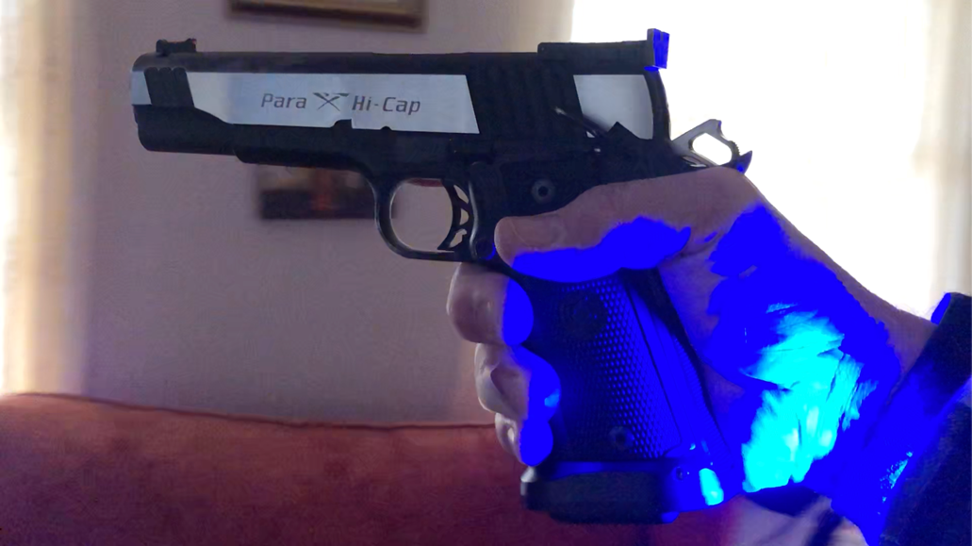
Samaritan Smart Band:
The Samaritan Program’s proprietary 911 Smart-Band ID / communication device serves critical life-saving functions:
  Only available and issued by law enforcement to a Samaritan Program graduate who volunteers to be registered in the TSP query-able national database,
  Activates immediately upon the wearer affirmatively gripping the sympathetic grip switch on their gun,
  Emits bright blue flashing LED lights alerting the public and LEO’s that the wearer is Samaritan Program trained, giving LEO’s a moment’s hesitation to discern if the wearer is, or is not a threat, before using force,
  Auto-dials 911 with integrated speaker/microphone to enable hands-free communication to first responders to prevent blue-on-blue tragedies,
  Provides precise GPS location of the Samaritan, so responding LEOs have greater situational awareness, and can respond to the proper location to deal with the actual threat.
C 2019

Slide 53
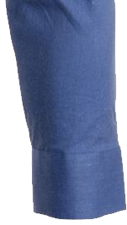
911 Smart-Band:
C 2019

Slide 54
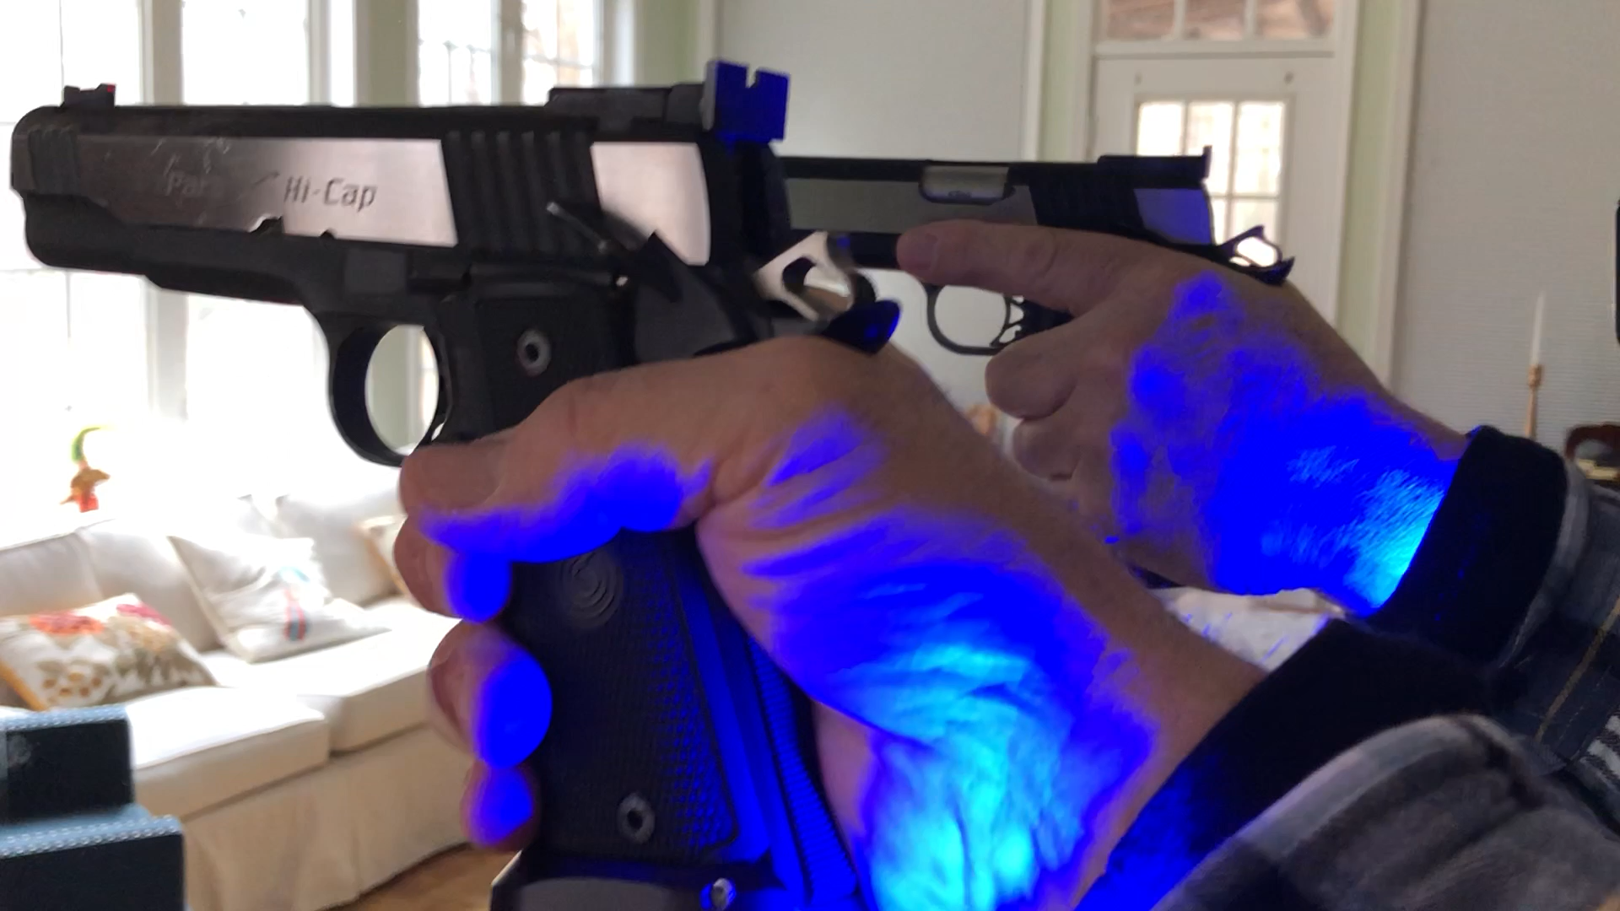
Samaritan Smart Band:
The Samaritan Program’s proprietary 911 Smart-Band’s flashing blue LED beacon is clearly visible from both sides, in all light conditions from daylight to darkness, for immediate life-saving recognition and discernment by first responders.
C 2019

Slide 55
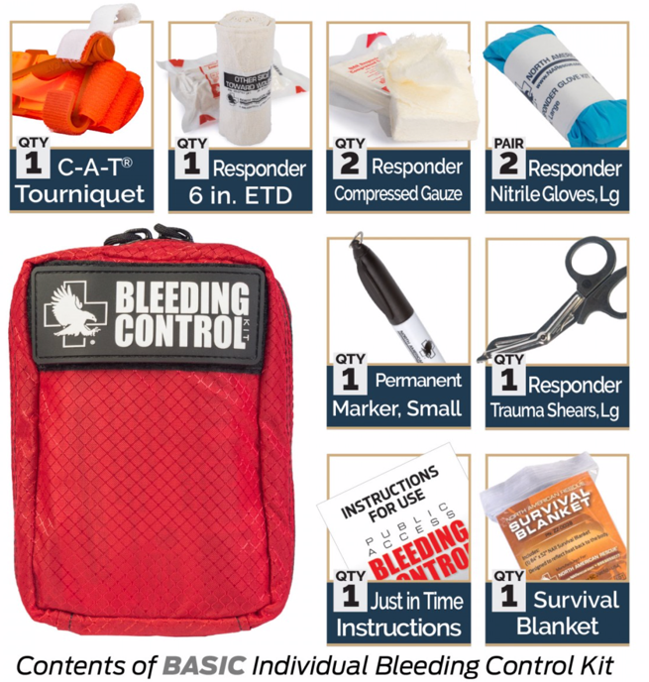
Bleed-Control Kits:
Objectives:
The Samaritan Program’s Bleeding Control Kits feature professionally-vetted, cutting-edge products packaged for a variety of skill levels, and including:
  The necessities to extend the life of someone who has suffered a traumatic bleeding injury, especially injuries related to gunshot wounds,
  A compact pouch containing an easy-to-use tourniquet, hemostatic or cotton gauze, latex gloves, shears, survival blanket, etc,
  Simple-to-follow instruction card graphically demonstrating use, and a marker to take notes and denote exact time a tourniquet is applied.
C 2019

Slide 56

Samaritan Database:
The Samaritan Program’s nationwide, law enforcement query-able Database will serve the following purposes:
  To document the name, identification, biometric data, and photo of Samaritan Program graduates in order to link them to their police-issued, serialized Smart-Bands,
  Entry into the Database is entirely voluntary and only done when a Samaritan grad buys/registers their Smart-Band.
  Allows police queries to verify ID of Samaritan Program graduates for official law enforcement purposes,
  If a Samaritan Smart-Band is activated by it’s registered user who resolves to intercede in a violent situation, the Smart-Band will auto-dial 911, and the Database will be queried, providing the police dispatcher with full ID data and photo of the Samaritan, to inform the responding police officers.
C 2019

Slide 57
Revenue:
The Samaritan Program is a truly unique private-sector venture, in cooperation with the public sector, which encompasses unparalleled scope and tremendous significance due to its life-saving potential. The Samaritan Program will include branding and merchandising efforts that reflect that reality, and will capitalize on the potential revenue streams which the program creates.
C 2019

Slide 58
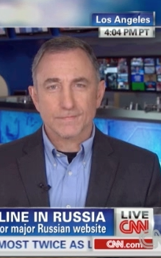
PROMOTION/MARKETING:
Objective:
Rapidly spread the word about the launch of The Samaritan Program far and wide:
Press releases will be immediately followed by TV appearances by our subject matter experts, some of whom regularly appear on a wide variety of TV news shows,
Interviews will be arranged with institutions that are both friendly and hostile to gun ownership, to engage all sides in this dialog. Our side is an argument about how to save lives. There is no reasonable opposing view to that.
Electronic and print media will be utilized, including our own partners, Gun Digest, Recoil, Recoil Concealment, and others, to generate the greatest buzz for what will very likely be considered a revolutionary development in the responsible ownership, carry, and use of weapons in regard to public safety. This should lead to increased add and publication sales.
C 2019

Slide 59

Documentary Series:
Objectives:
To spread awareness and broadcast successes:
  Develop, pitch, and sell a situationally-driven docu-series showing the diversity of people completing The Samaritan Program training, highlighting the wide variety of reasons for partaking,
  Feature live interviews, along with actual or news footage of real cases to highlight interesting and exemplary cases of life-saving intervention, and feature those whose lives have been saved,
  Provide expert evaluations, re-enactments, or graphics to demonstrate how civilians’ actions saves lives, while identifying the lessons learned,
  In success, these creative ventures will serve to not only cross-promote and generate interest in The Samaritan program, but will be significant revenue streams themselves.
C 2019

Slide 60

Franchising:
Objectives:
The Samaritan Program will be licensed nationwide to equip as many people as possible to save lives:
  Similar to the “CrossFit” business model, The Samaritan Program will certify appropriate instructors and facilities to carry out our officially sanctioned training curriculum,
  Training facilities will benefit from utilizing our curriculum to expand existing business and increase client base for follow-on training,
  Our experts will conduct initial on-site training and certifying of facilities and faculty, and each new “franchise” will have its course audited by our team for quality assurance.
  The program licensing fees will be a significant revenue source, as will teaching materials.
C 2019

Slide 61

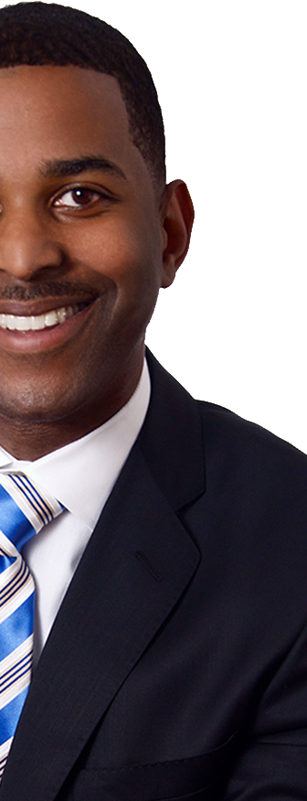

Merchandising & ID:
Objectives:
To build the brand and promote the cause we will:
  Create original or white-label clothing and accessories made specifically for concealed carry, including holsters, medical kits and gear, and accessories,
  Design and or sell range bags, hearing and eye protection, targets, and other gear for enthusiasts,
  Market branded T-shirts, hats, sweatshirts, jackets, and specialty Samaritan Program clothing available via our website, online retailers, and through our network of franchised and certified training facilities,
  Create a unique Samaritan Program ID card, coins, patches, bracelets, lapel-pins, etc, for Samaritan pride and recognition by peers.
  Use these articles to provide a year-round revenue stream, which can be cross-promoted in our partner publications and will be part of a continuously evolving product line, to reflect market trends.
C 2019

Slide 62

Samaritan Insurance:
Objectives:
To support and protect the graduates of the Samaritan Program we will secure and offer a variety of cost-saving group insurance options from reputable companies:
  Concealed carry policies – as added protection in order to successfully survive the “Third Conflict” after a use-of-force encounter,
  Property loss gun policies/riders – to protect guns and related possessions from fire, theft, and other occurrences,
  Professional liability policies – for law enforcement officers to protect them during the performance of their official duties, above and beyond support their agency might provide.
  The Samaritan Program will act as sales agent on a commission/fee basis.
C 2019

Slide 63

Conventions/Events:
Objectives:
To raise awareness and generate interest in The Samaritan Program’s civic-safety agenda we will:
  Create a large, annual, Samaritan Program convention as a destination event similar to ”Comic-Con,” ”Crime-Con,” and others, which allow supporters and enthusiasts to gather to learn, exchange stories and ideas, and socialize.
  Create smaller, regional events to reach a wider population and greater participation by those who can’t travel to national events.
  Display at large trade shows such as Shot Show in las Vegas, to market the program, its learning aids, merchandising materials, and memorabilia.
  Sponsor and display/sell merchandise at local gun shows, firearms training facilities, farmer’s markets, community events, and similar functions.
  These types of events are generally very lucrative, and as such are expected to provide substantial revenue streams (though a non-profit, Comic-Con revenue is $10mm to $20mm per convention.)
C 2019

Slide 64
Contact US:
For additional information or to contact THE SAMARITAN PROGRAM, please use:
Web: www.samaritanprogram.com
Email: info@samaritanprogram.com
C 2019

